Slide 1
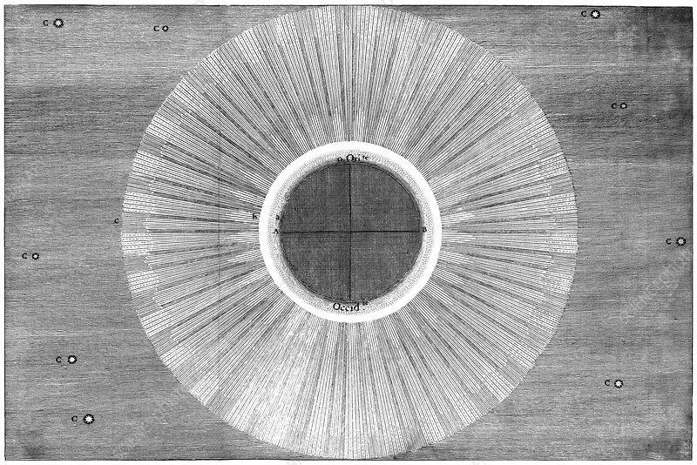
Lec 9: A Sampling of Eclipses in Art
© Gerard Williger 2023 U Louisville
We have been watching the sky for thousands of years
Eclipses were regarded with fear for a long time, even when we could predict them
Our changing view of them is reflected in art to this day
Many references from Blatchford 2016, Phil. Transactions of Royal Society
1778 eclipse, A. de Ulloa

Slide 2
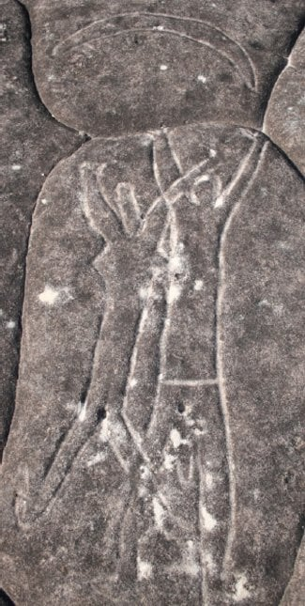
Australian Aborigines
© Gerard Williger 2023 U Louisville
Petroglyph, Ku-rin-gai Chase Nat’l Park, NSW, Australia
24 km from central Sydney
For many aboriginal communities, eclipses associated with fear
Sun associated with woman, Moon a man
link

Slide 3

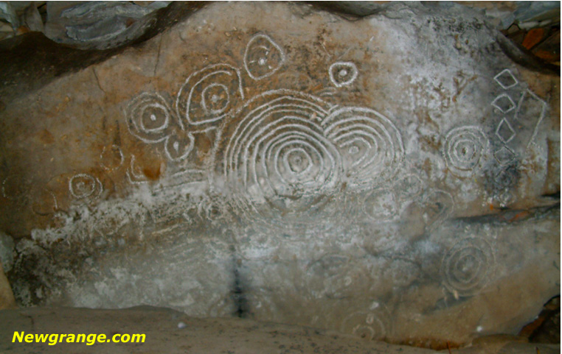
Nov 30, 3340 BC Loughcrew, County Meath, Ireland
© Gerard Williger 2023 U Louisville
Spirals: alignments of Sun, Moon, horizon during eclipse 3340 BC
Basin held burnt bones from about 48 people
Human sacrifices to save the sky god (Sun)? Link

Slide 4
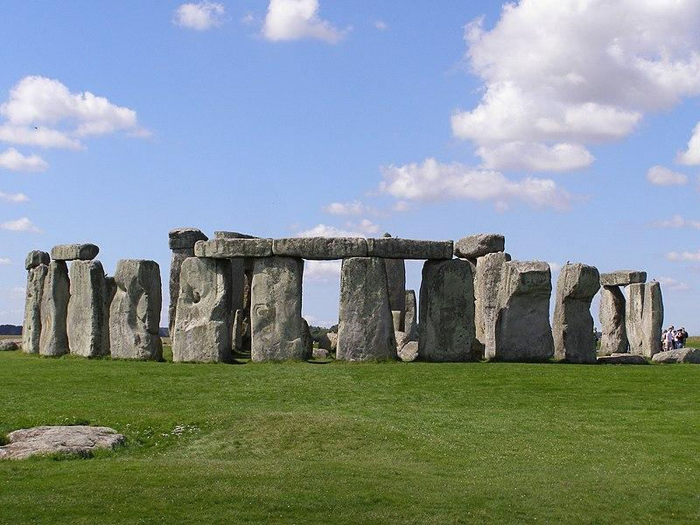
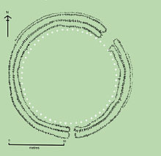
c. 3000 BC Stonehenge
© Gerard Williger 2023 U Louisville
Lunar eclipses can only happen every 5-6 lunations (full Moons) = every 148 or 177 days
Solar eclipses are +/- 2 weeks from each lunar one
Stonehenge: 56 Aubrey holes in ring, can be used to keep track of Sun, Moon → predict eclipses (T. Nordgren 2016, p37, Sun, Moon, Earth)
Stonehenge, Gareth Wiscombe 2007, Wikipedia
Aubrey holes in white
Drawing by Adamson, Wikimedia

Slide 5
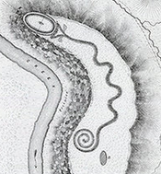
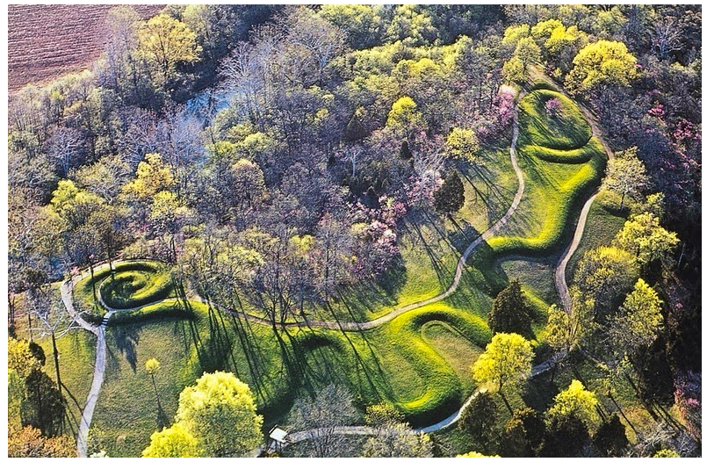
c. 800-100 BC Serpent Mound
© Gerard Williger 2023 U Louisville
Adams County, S Ohio (Ohio Valley)
Renovated c. 1400 AD
In many native American cultures: eclipse = monster (snake here) swallows Sun
then spits it out or is killed by a hero
Squier & Davis, 1848, Ancient Monuments of the Mississippi Valley
barry.warmkessel.com

Slide 6
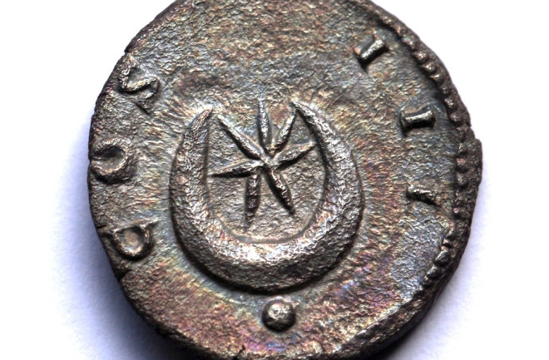
118 AD Hadrian’s Coin
© Gerard Williger 2023 U Louisville
"Star and crescent" coin made during the reign of the Roman emperor Hadrian (76-138, emperor 117-138)
coin minted 125-128?
inspired by total eclipse of September 3, 118
path fell on the northern part of the Roman Empire. (Credit: Richard Jakiel)
LInk1, Jakiel 2019, Discover Magazine
Link2, Waugh 2013, blog

Slide 7
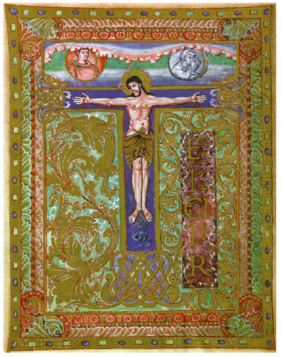
c. 850 AD Metz Sacramentary
© Gerard Williger 2023 U Louisville
The Sacramentary of Metz, Biblioth. Nat. (Paris), publ. w. permission of Akademische Druck -u. Crucifixion, Metz Sacramentary c. 850.
Represents Church as a mourning Moon
Ref Blatchford 2016

Slide 8
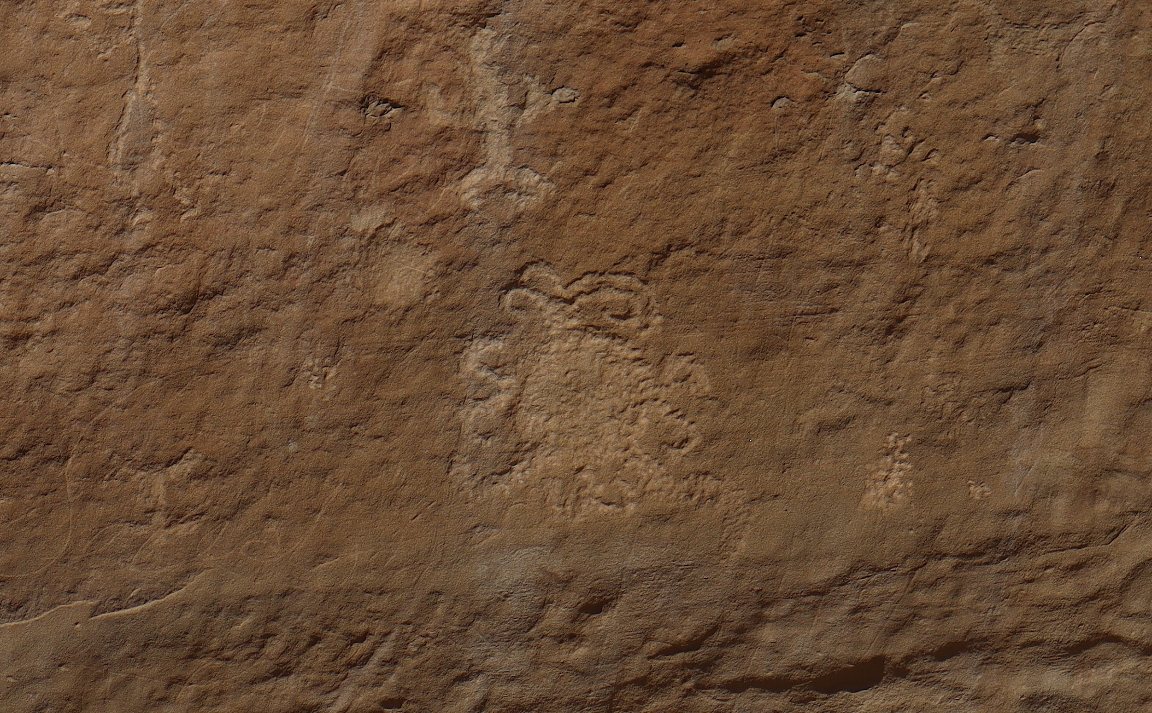
1097 Chaco Canyon, New Mexico
"Rock of the Sun" petroglyph
thought to depict a total solar eclipse from 11 July 1097.
Other eclipses there were in 1194 and 1259, when region is thought to have been deserted.
14 Oct 2023 annular eclipse also!
link
© Gerard Williger 2023 U Louisville
Photo: Gill Carter

Slide 9
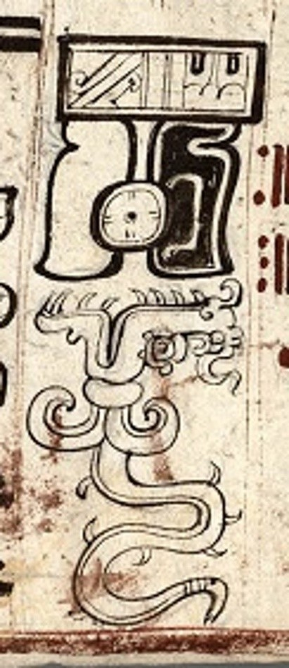
c. 1100-1200 Maya, Central America
© Gerard Williger 2023 U Louisville
Glyph from Dresden Codex showing a dragon-like "star demon” about to devour the sun during an eclipse.
Planets suddenly visible in day thought to be “star demons” (e.g. snakes, giant insects) devouring Sun
link

Slide 10
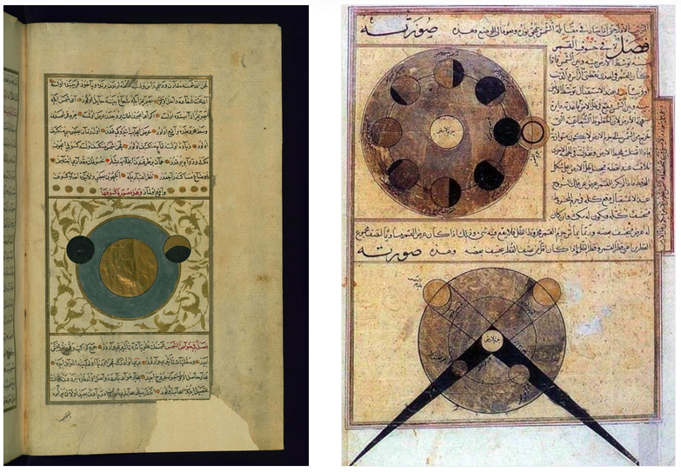
c. 1250 Wonders of Creation
© Gerard Williger 2023 U Louisville
Zakariyya ibn Muhammad al-Qazwini (1203-83)
pages from Aja'ib Al Makhluqat wa Ghara'eb Al Mawjodat (“The Wonders of Creation”)
“… the moon becoming a barrier between our sight and the sun, because the moon is an opaque celestial body that blocks the view of what lies behind it. If it is conjunction with the sun and it is in one of the two points, "the head" or "the tail," or near them, it passes under the sun and obstructs the vision".
Fun fact: “head”, “tail” from “dragon eating sun” myth LINK

Slide 11
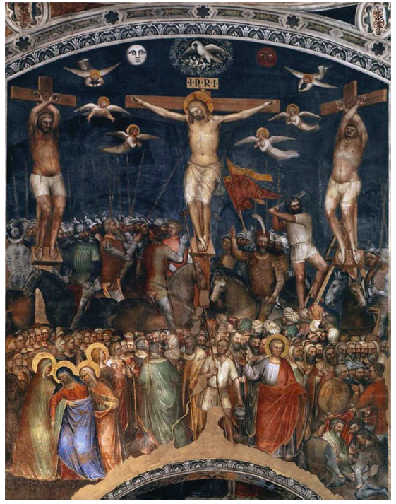
c. 1378 Crucifixion de Menabuoi
© Gerard Williger 2023 U Louisville
“This fresco in the Padua Baptistery … portrays the crucifixion of Jesus Christ during an eclipse, painted by Giusto de Menabuoi … . Crowds of onlookers stand around and the Virgin Mary has fainted.” (Blatchford 2016).
Note Moon is red from a lunar eclipse

Slide 12
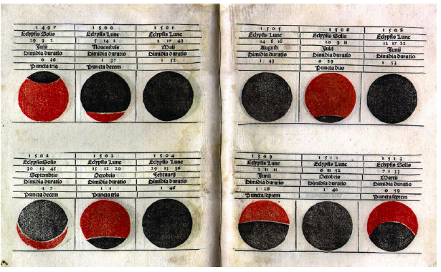
1476 Kalendarium Regiomontanus
© Gerard Williger 2023 U Louisville
“Important astronomical texts began to use impressive illustrations”
(Blatchford 2016)
Claimed used by Columbus for Mar 1, 1504 lunar eclipse, Jamaica ; Columbus wrote that he used the Almanach by Abraham Zacuto (LINK)

Slide 13
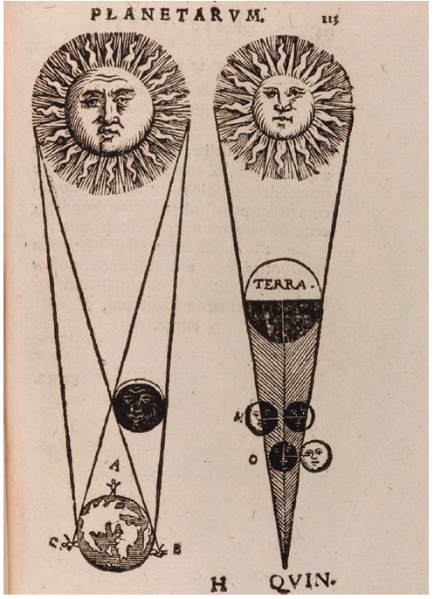
1553 Theoricae Novae Planetarium
© Gerard Williger 2023 U Louisville
More impressive illustrations from astronomical texts (Blatchford 2016)
Work by Georg von Peuerbach; artist unknown

Slide 14
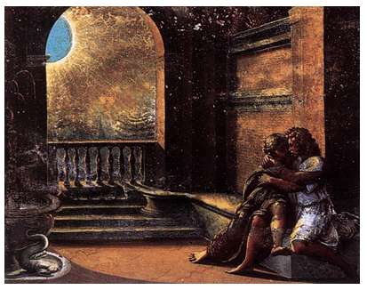
1518-19 Raphael and Workshop
© Gerard Williger 2023 U Louisville
Isaac, Rebecca and Abimelech, fresco in Vatican
“… workshop may have witnessed annular eclipse … in June 1518 … [which is] what is painted” (Blatchford 2016).
“Isaac and Rebecca are taking advantage of the muted light from the eclipsed Sun, while the king of Philistines is spying on them (… shadow behind balcony…). ... Viewer knows that as the eclipse passes their secret assignation will be revealed to Abimelech in a shaft of radiant sunlight.” (Blatchford 2016)

Slide 15
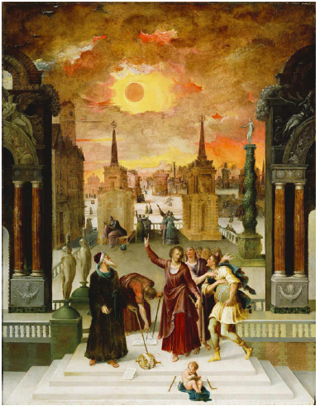
c. 1570s Antoine Caron
© Gerard Williger 2023 U Louisville
“… a Greco-Roman cityscape … .
In the background, people run in different directions.
The chaos of the scene is heightened and dramatized by the blackened disk with an orange aura that looms in the darkening, [crimson] sky.” (Laura Valenza, link)
Dionysius the Areopagaite Converting the Pagan Philosophers

Slide 16
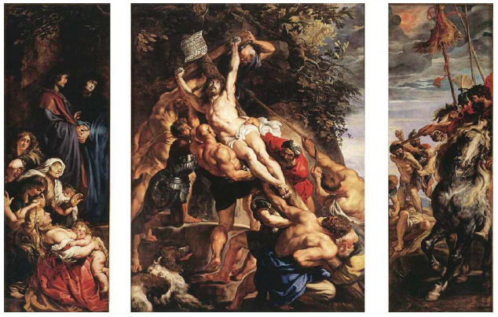
1610 Rubens
© Gerard Williger 2023 U Louisville
Elevation of the Cross, tryiptych for Antwerp Cathedral
“… Sun appears on Christ’s left … and left hand panel includes an un-eclipsed Moon hidden behind trees.” (Blatchford 2016)

Slide 17
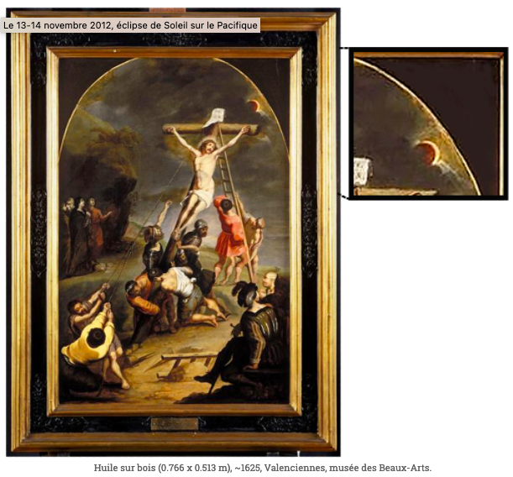
1625 Cornelis de Vos
© Gerard Williger 2023 U Louisville
Elevation of the Cross, Valenciennes, Musée des Beaux-Arts
LINK
Note detail of 90% eclipsed sun through clouds

Slide 18
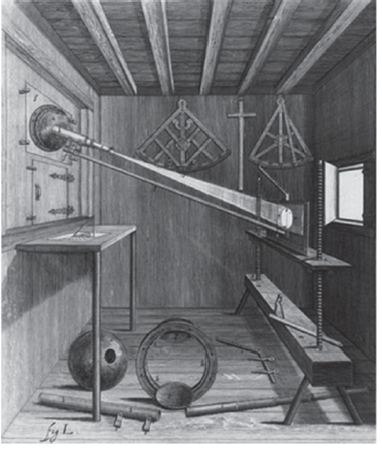
1647 Darkened Room (Camera Obscura)
© Gerard Williger 2023 U Louisville
Science + art contributions by Polish-German Lutheran astronomer Johannes Hevelius
“… Hevelius realized that improved observations need to be matched by excellence in draughtsmanship … therefore, he trained himself to engrave in copper …” (Blatchford 2016)
Used to project images of sun on a screen, for safe observations

Slide 19
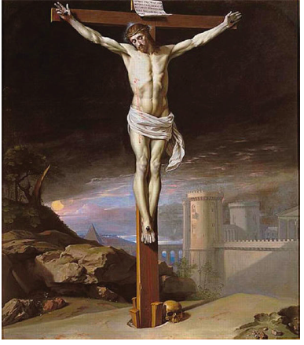
1655 Philippe de Champaigne
© Gerard Williger 2023 U Louisville
“…solar eclipses were the perfect choice for illustrating the traumatic light described in the Gospel,”
(Blatchford 2016)
Musée des Beaux Arts, Grenoble, France

Slide 20
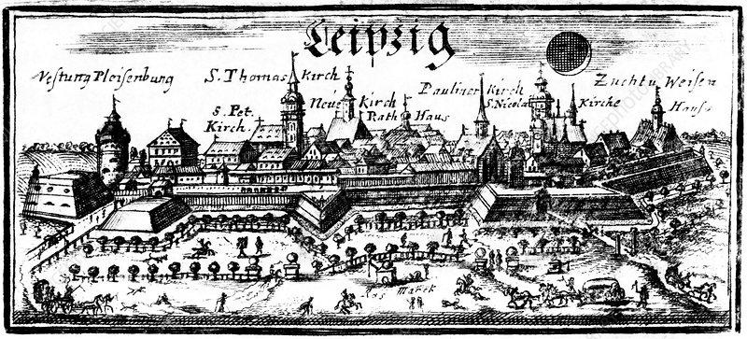
1715 Leipzig
© Gerard Williger 2023 U Louisville
Historical artwork during solar eclipse of 3 May 1715. Note city wall and people in everyday life. Roy. Astron. Soc. LINK

Slide 21
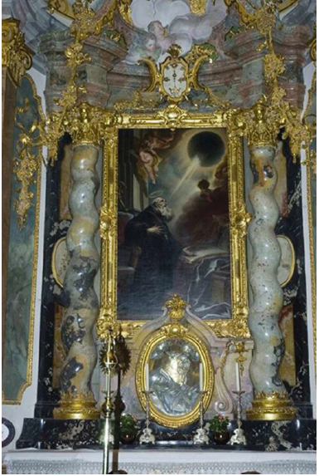
1735 Cosmas Damian Asam
© Gerard Williger 2023 U Louisville
Vision of St. Benedict, monastery church of Weltenburg, Germany
St. Benedict blessed with vision of creation in beam of sunlight
May show diamond ring effect and Baily’s beads
Olson & Pasachoff 2011, Astron. Soc. Pacific conf. ser., 441, 205-15

Slide 22
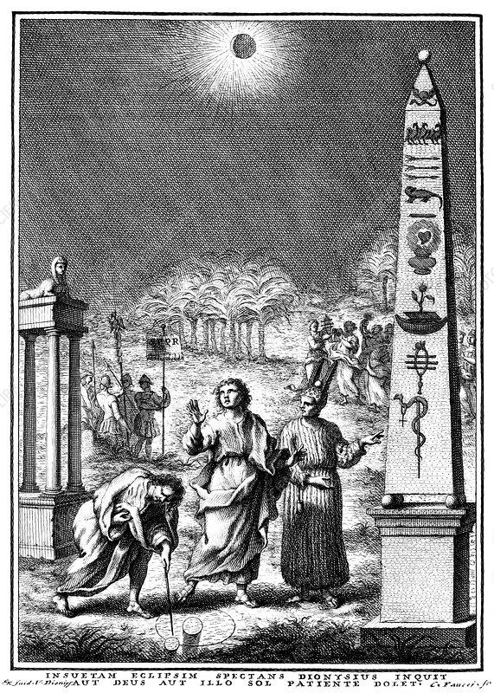
1747 Scientia Eclipsium
© Gerard Williger 2023 U Louisville
Giuseppe Simonelli et al. Depiction of solar eclipse in ancient Rome.
Dionysus (Bacchus) with legions (left) and followers (right) LINK
“Gazing at the unprecedented eclipse, Dionysus says that either God or the sun is in mourning for the suffering of man.

Slide 23
June 24, 1778 Corona, A. de Ulloa
© Gerard Williger 2023 U Louisville
Antonio de Ulloa, Spanish general, explorer, author and astronomer. Corona during eclipse, surrounded by stars (‘c’). LINK
Corona during eclipse, surrounded by stars (‘c’). Start of more scientific realism. LINK

Slide 24
1827 Gallo Gallina
© Gerard Williger 2023 U Louisville

Slide 25
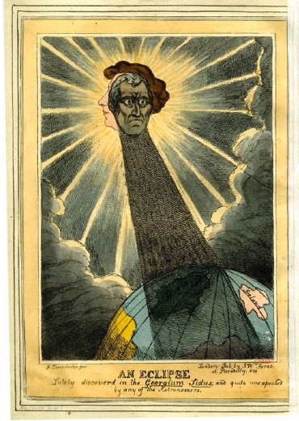
1829 Satire: Georgium Sidus
© Gerard Williger 2023 U Louisville
“… scientific concepts and ideas were permeating wider popular culture…”
“… Wellington shown eclipsing King George IV and casting a shadow over England but not Ireland. Wellington favoured Irish Catholic causes…”
(Blatchford 2016)
The Irish-born Arthur Wellesley, Duke of Wellington, then Prime Minister, was attacked for the passage of the Roman Catholic Relief Act.

Slide 26
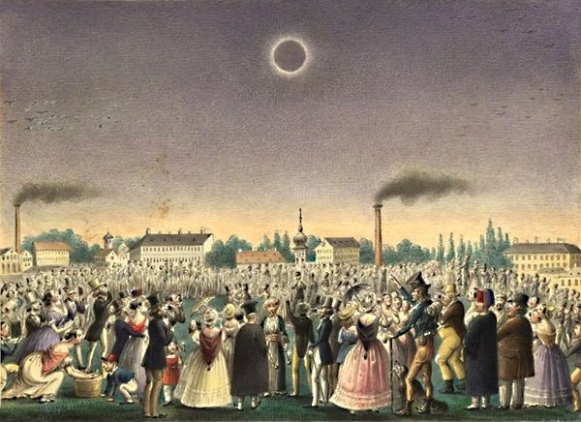
1842 Vienna - Schoeller
© Gerard Williger 2023 U Louisville
Johann Christian Schoeller painted this scene depicting crowds of people viewing the July 8, 1842, total solar eclipse over Vienna, Austria. LINK
Eclipses have become something to be enjoyed by all people.

Slide 27
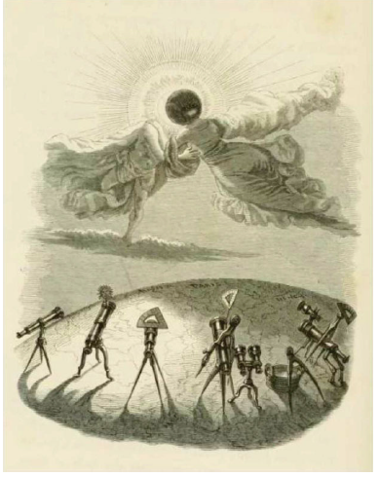
1844 Grandville
© Gerard Williger 2023 U Louisville
“Jean Jacques Grandville … shows an eclipse as a kiss between two lovers … rudely intruded upon by the gaze of an array of observational devices and, by implication, the bustling middle classes.”
Blatchford 2016, Olson & Pasachoff 2011
From: Un Autre Monde, Grandville 1844

Slide 28
1869 Columbus – J.S.C. Abbott
© Gerard Williger 2023 U Louisville

Slide 29
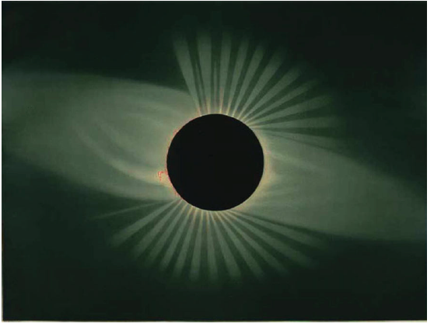
1878 Corona – E. Trouvelot
© Gerard Williger 2023 U Louisville
“Magnificent [chromium lithograph of] pastel drawing by Etienne L. Trouvelot of the Sun's corona during the total solar eclipse of May 29, 1878.”
Credit: American expedition to Wyoming. LINK

Slide 30
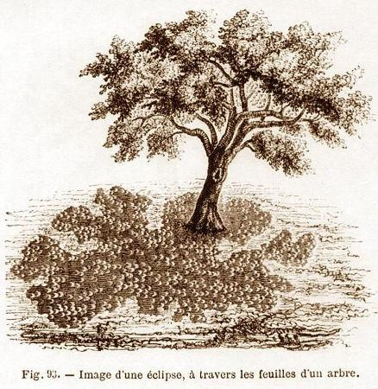
1880 Crescent Shadows – Flammarion
© Gerard Williger 2023 U Louisville
Drawing of crescent-shaped shadows through leaves by Camille Flammarion during a partial solar eclipse. LINK
Eclipse effects are enjoyed for their beauty.

Slide 31
Oct 31, 1883 M. Miyazawa
© Gerard Williger 2023 U Louisville

Slide 32

Late 19th cent. Zhang and Tiangou
© Gerard Williger 2023 U Louisville
The New Year Painting of Zhang Xian, China
“Zhang the immortal shooting a pebble bow at a heavenly dog [Tiangou]”, thought to ‘eat’ the sun during eclipses. LINK
Because of the painting's association with the story of Lady Flower Stamen, a concubine of the first Song Emperor Tai Zu, it is often interpreted as a metaphor for fertility. Wikimedia.

Slide 33
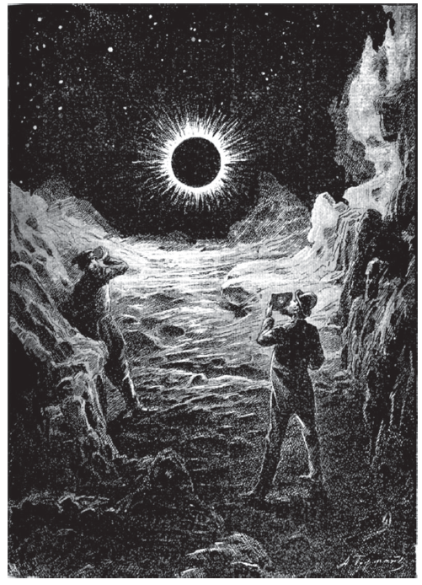
1887 On the Moon
© Gerard Williger 2023 U Louisville
Image from On the Moon, novel by Konstantin Tsilkovsky, 1893 - illustration by A. Gofman.
Two men journey to the Moon to see an eclipse
Science fiction begins to employ eclipse themes.

Slide 34
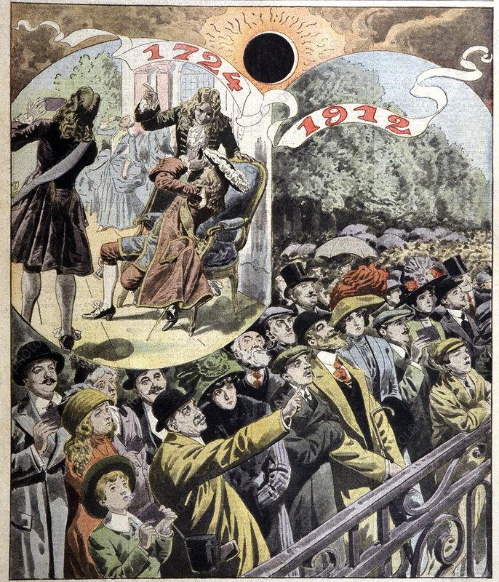
1912 Paris Eclipses
© Gerard Williger 2023 U Louisville
French solar eclipses of 1724 and 1912. Historical artwork of people watching the total solar eclipse of May 22, 1724 (upper left) and the annular solar eclipse of April 17, 1912 (lower right).
2 days after Titanic sank
Le Petit Journal LINK
Everyone is enjoying eclipses

Slide 35
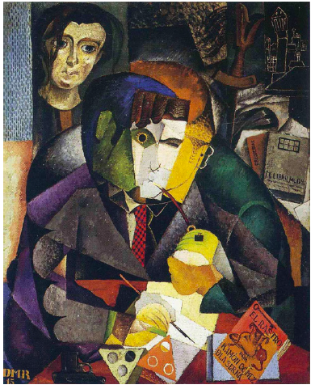
1915 Diego Rivera
© Gerard Williger 2023 U Louisville
Portrait of Ramon Gómez
Diego Rivera [an eclipse aficionado] rushed to roof of Detroit Inst of Art (while painting his famous murals) to witness a partial eclipse. (Blatchford 2016).
Note eclipses in eye, palette.

Slide 36
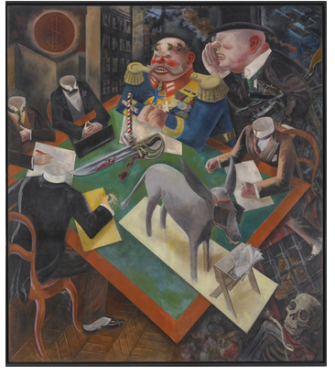
1926 George Grosz
© Gerard Williger 2023 U Louisville
Eclipse of the Sun
The almighty American dollar brands the moon as it blacks out the sun
“ … the eclipse becomes a sign of despair and the approaching political apocalypse in an unstable Weimar Republic …”
Laura Valenza LINK
[Note theme of cross with eclipse above, as in past centuries.]

Slide 37
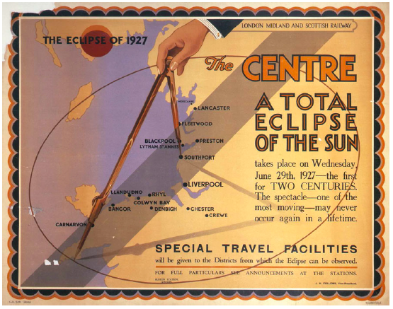
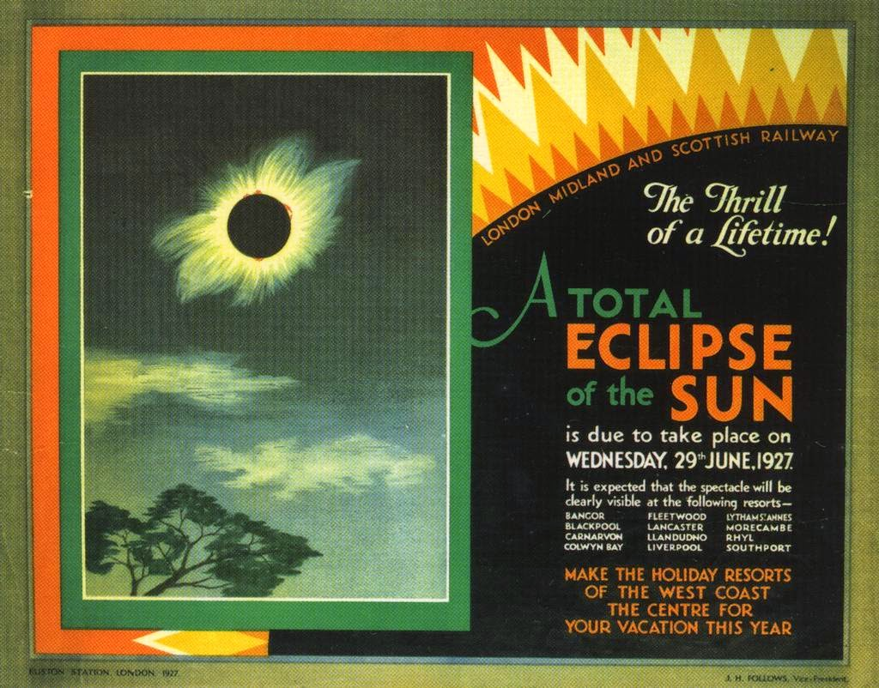
1927 LM&S Railway Posters
© Gerard Williger 2023 U Louisville
London, Midland and Scotland Railway posters. People are invited to travel to eclipses! Left: Blatchford 2016. Right: LINK

Slide 38
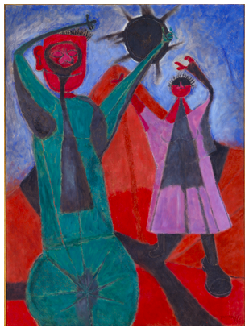
1946 Rufino Tamayo
© Gerard Williger 2023 U Louisville
“According to Zapotec [Oaxaca, Mexico, c. 700 BC – 1521 AD] mythology, the total eclipse is an evil omen that prophesies disaster, warfare, or the end of the world.
In Total Eclipse, a pitch-black moon shields the sun, and the blue heavens are filled with shards of darkness rather than rays of hopeful light.”
Heather Cammarata-Seale, LINK

Slide 39
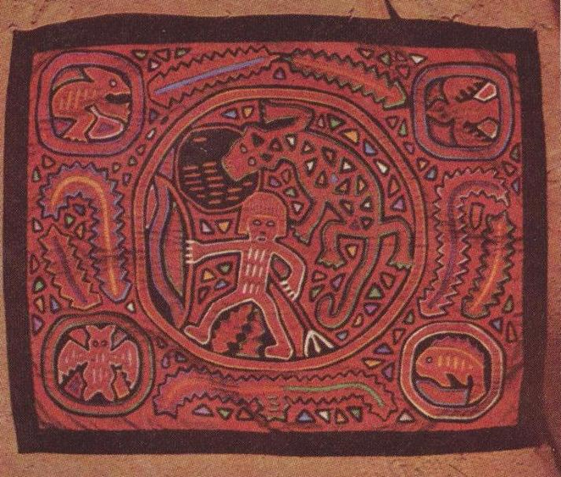
Mola art, Panama, mid-20th cent.
© Gerard Williger 2023 U Louisville
Textile art from Guna people
Adapted from body painting
LINK1
LINK2
Photo source: Dr. B. Follensbee, Missouri St. U.
“Albino shoots the Sky Dragon” – ancient story where an albino (a “moon child”) shoots the sky dragon trying to swallow the Moon

Slide 40
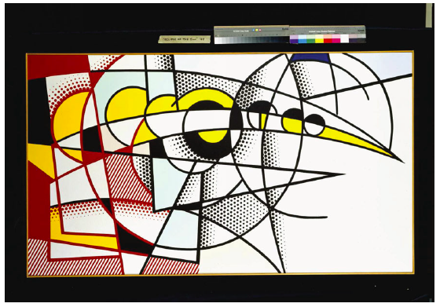
1975 Lichtenstein
© Gerard Williger 2023 U Louisville
“Pop artist Roy Lichtenstein was interested in the time lapsed (successive) phases of an eclipse in his Eclipse of the Sun II (1975).”
(Blatchford 2016)

Slide 41
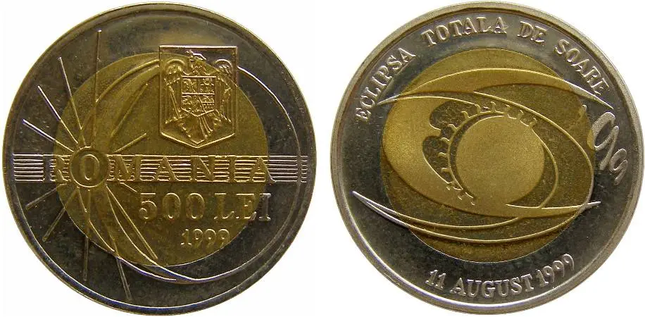
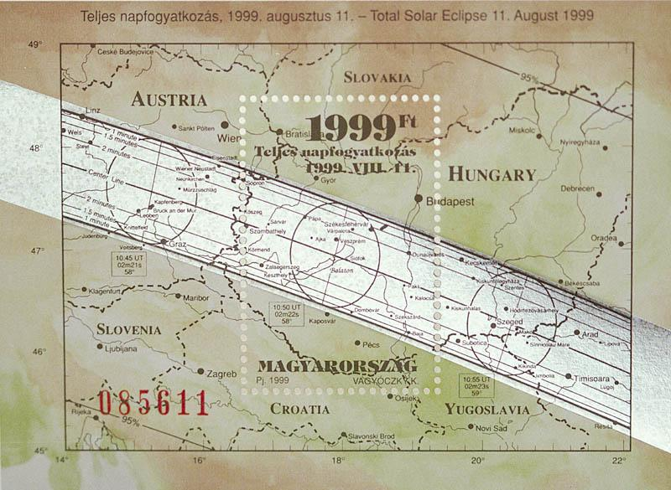
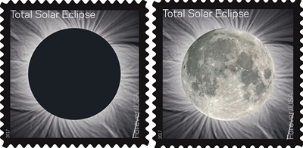
1999, 2017 Stamps, Coin
© Gerard Williger 2023 U Louisville
A
B
C
A) Romania 1999. B) Hungary 1999. C) USA 2017. (Both stamps use F. Espenak’s work!)
Eclipses on coins became more popular at the end of the 20th century – and also on stamps.

Slide 42
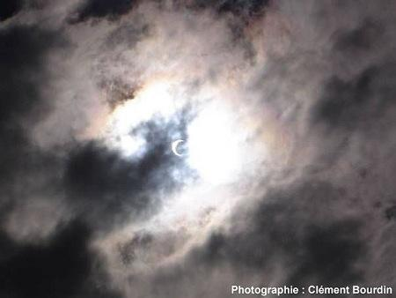
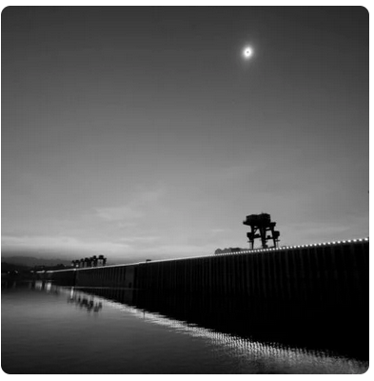
2005-09 Artistic Photos
© Gerard Williger 2023 U Louisville
Partial eclipse on 3 Oct 2005, Clément Bourdin, Europe, similar to de Vos (1625). LINK
22 July 2009, Yi Chaing, Three Gorges Dam, Hubei, China. Totality was 6’39” – longest of the 21st century. LINK

Slide 43
2017 Q.T. Luong
© Gerard Williger 2023 U Louisville

Slide 44
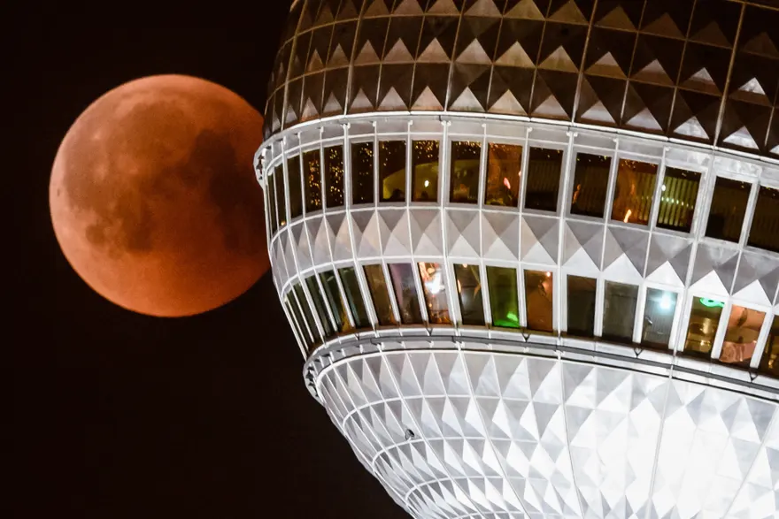
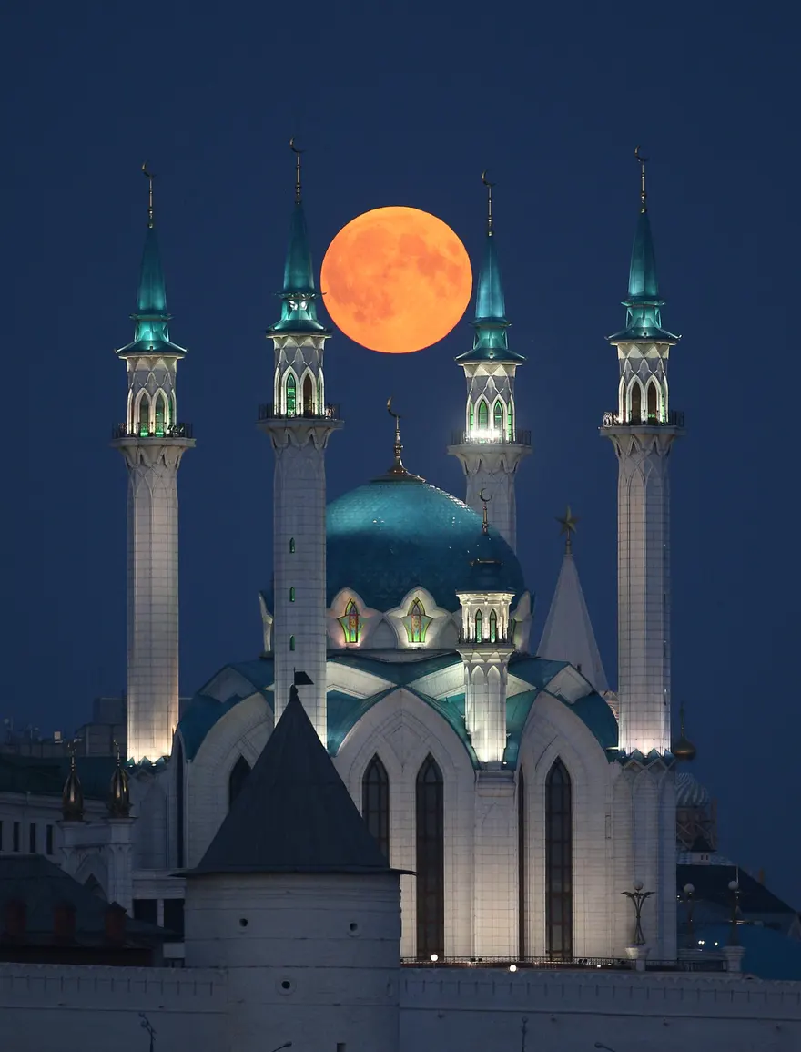
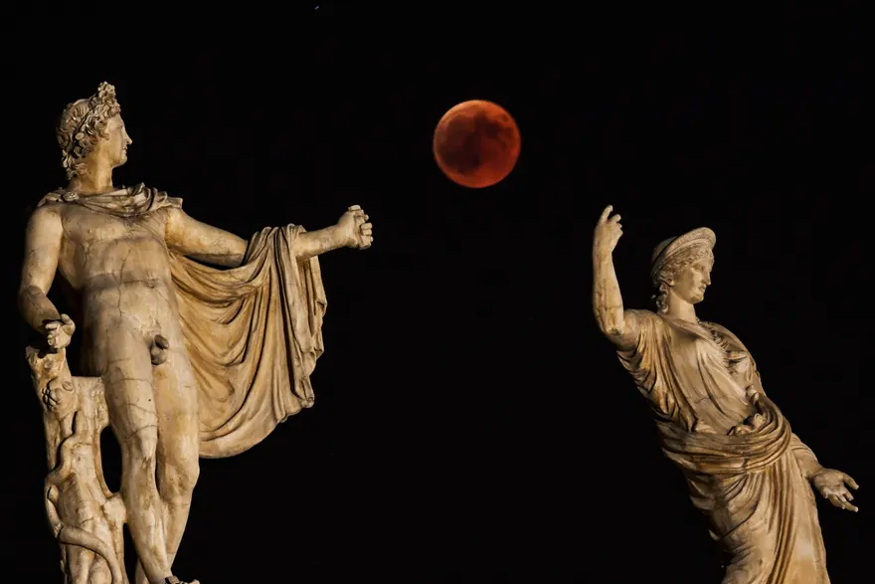
2018 Press Photographers: Whimsy!
© Gerard Williger 2023 U Louisville
Lunar Eclipse of 27 July 2018
Suspended over Qolsärif Mosque, Moscow, Yegor Aleyev, TASS
Collision with Berlin TV Tower, Christian Merz/EPA
Handball between Apollo (L) and Hera (R), Athens, Aris Messini, AFP, Getty Images

Slide 45
2024 And Beyond: ?????
© Gerard Williger 2023 U Louisville
Eclipses in art will continue to reflect our changing attitudes toward eclipses and modern methods to record them
Eclipses have now become modern “crowdsourced” events with ever more media coverage

Slide 46
SUMMARY
© Gerard Williger 2023 U Louisville
Eclipses recorded in art for > 5000 years
Eclipse Art spans all cultures!
Early art -- stylized, tends to bad omens
Medieval, Renaissance art – Biblical themes
Enlightenment: Fear gone, more scientifically accurate
Shows everyday life
Entered into satirical art
Industrial/Gilded age: reflected back on past fear
Started to emphasize beauty of eclipses, shadows
Showed more everyday people, beginning of travel to eclipses
20th century: reflected in modern art
Portrayed on more stamps/coins
21st century: photos become artistic, “trick shots”

